Slide 1
Anomaly Detection
Made by -
Soumyo Dey
Kartik Aggarwal

Slide 2
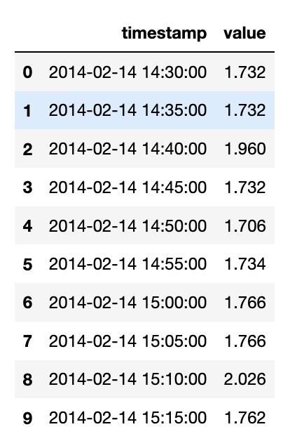
Problem Definition
Dataset
A company that creates and works on virtual machines in the cloud, such as AWS (EC2), is bound to encounter anomalies. To see if the cloud services are working perfectly or not, someone has to monitor them, detect these anomalies, and address them to prevent any future system failure.
We got our dataset from Numenta Anomaly Benchmark (NAB). It consists of 50 real world and artificial time series streaming data.

Slide 3
Data Flow
Python
Apache Kafka
Apache NiFi
MySQL
Python
As our current data is static, we are selecting only 2 weeks of CPU utilization values for every 5 seconds and sending this data to Kafka.
Kafka is used as a data transportation mechanism.The source system(Python) pushes data to Kafka, and then the target system(NiFi) sources the data from Kafka.
Apache NiFi is an ETL tool with flow-based programming that comes with a web UI built to provide an easy way (drag and drop) to handle data flow in real-time. It also supports powerful and scalable means of data routing and transformation.
Mysql is used to the data in the database
Finally python is used to extract data from the Mysql database and perform EDA and apply different algorithms to find the anomalies.

Slide 4
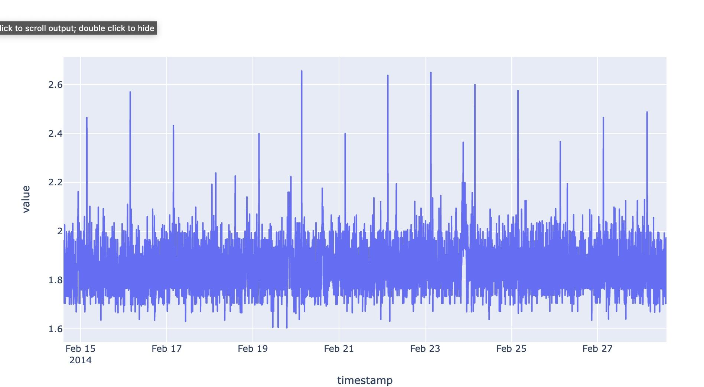
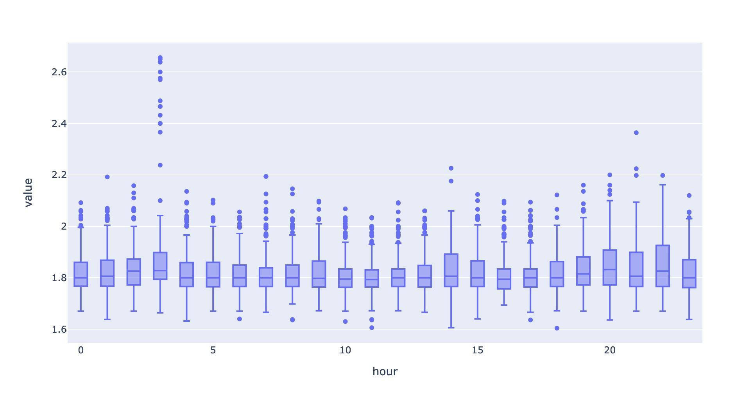
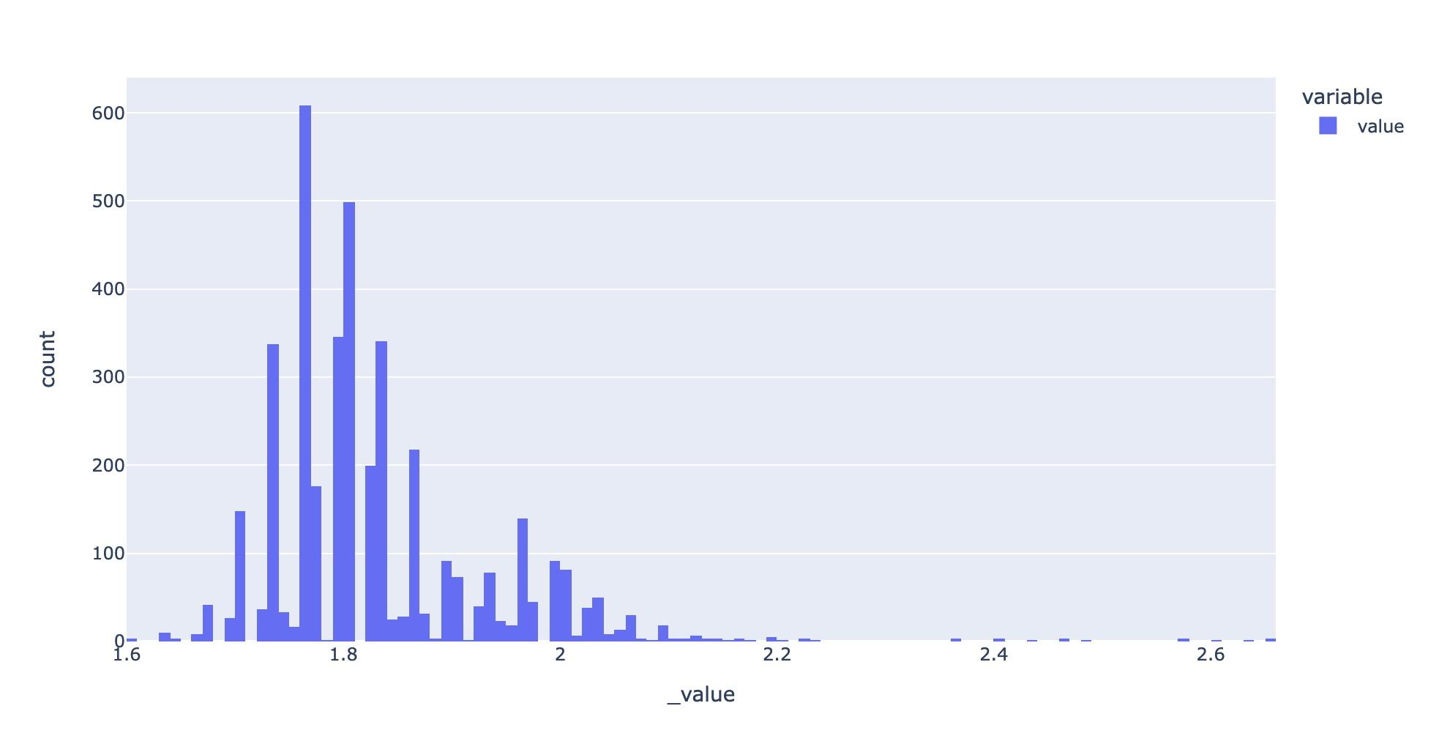
EDA
We can't really find any particular obvious outliers from the figure
Some obvious outliers appear
After we plot a histogram, we can be see that the data are mostly distributed within 1.616-2.016. Out of 4032 values 3821 values lie in the range

Slide 5
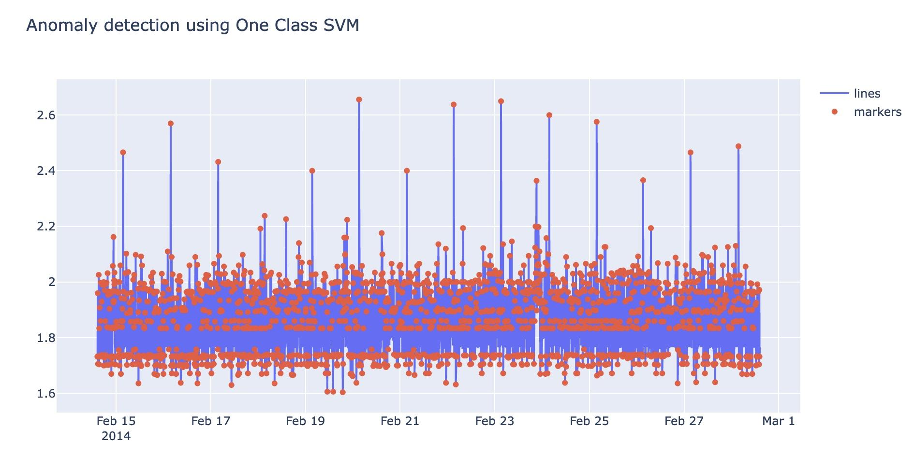
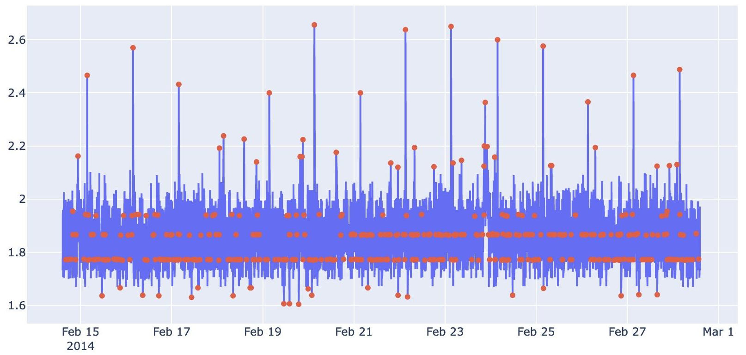
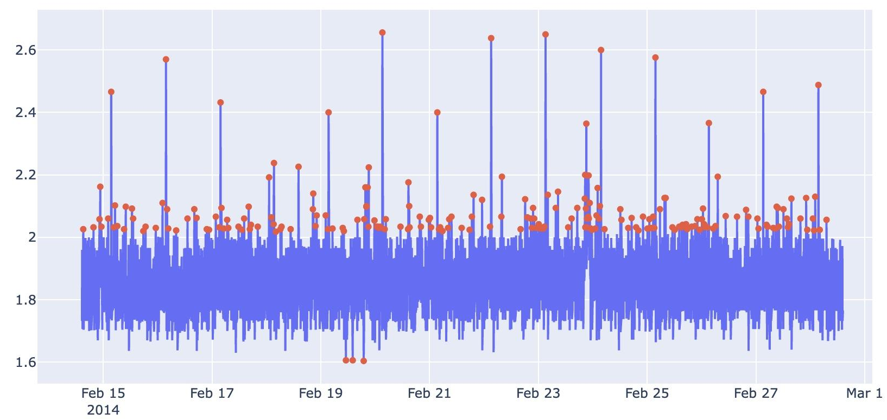
One class SVM
One class svm works on novelty detection. It uses a hyperplane to separate the anomalies from the normal data points.
It can be seen that there are many outliers, which are not what we expected, so we adjust the nu value and modify the parameters to fit the results.
After reducing the nu value, we can clearly see that we are getting close to the desired outliers. But to get the exact value of nu we use IQR which is a statistical method to calculate outliers. Once we get the best value of nu, we simply use that for one class SVM.
Finally we get the best output for anomaly detection by one class svm and calculate its em value.

Slide 6
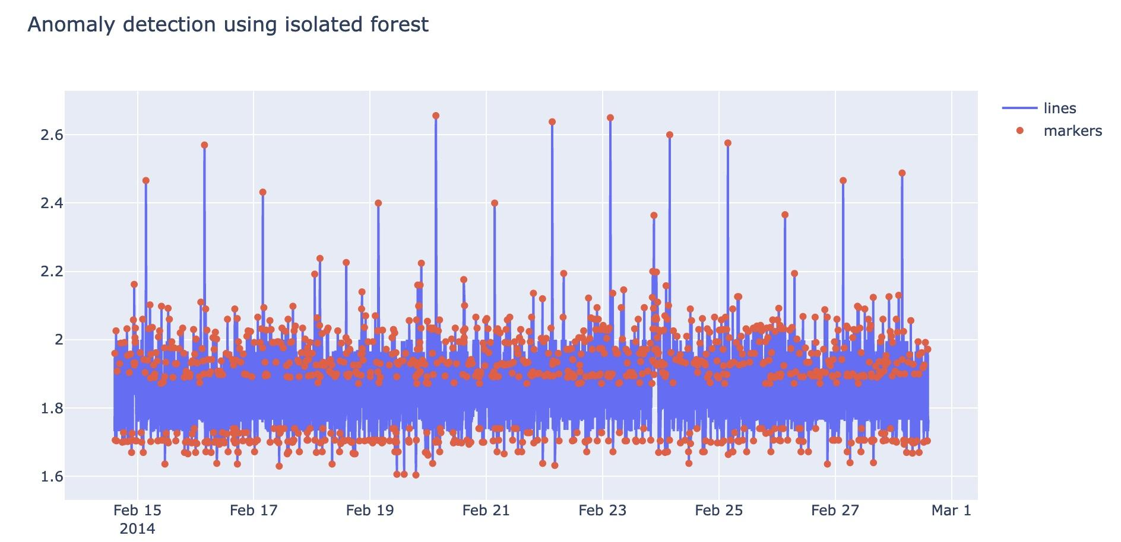
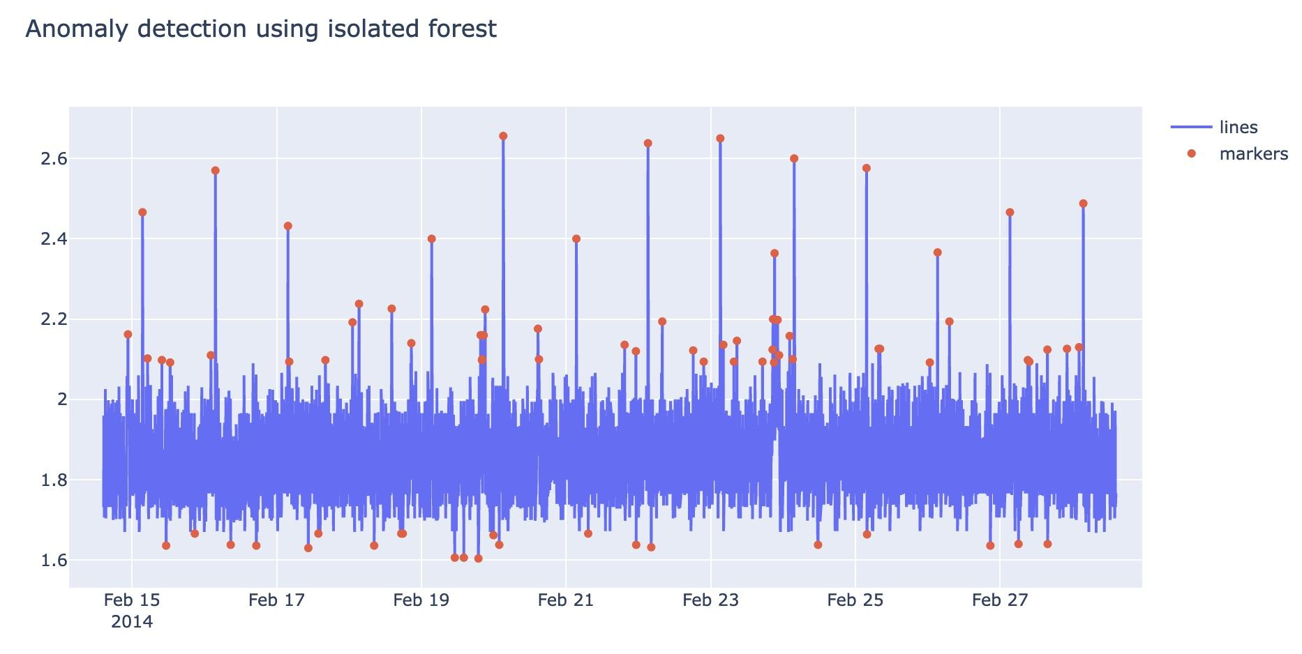
Isolation Forest
In an Isolation Forest, randomly sub-sampled data is processed in a tree structure based on randomly selected features. The samples that travel deeper into the tree are less likely to be anomalies as they required more cuts to isolate them. Similarly, the samples which end up in shorter branches indicate anomalies as it was easier for the tree to separate them from other observations.
We change the contamination factor to get a better result
We can see we get a way better output. We again calculate the EM score for isolation forest.

Slide 7
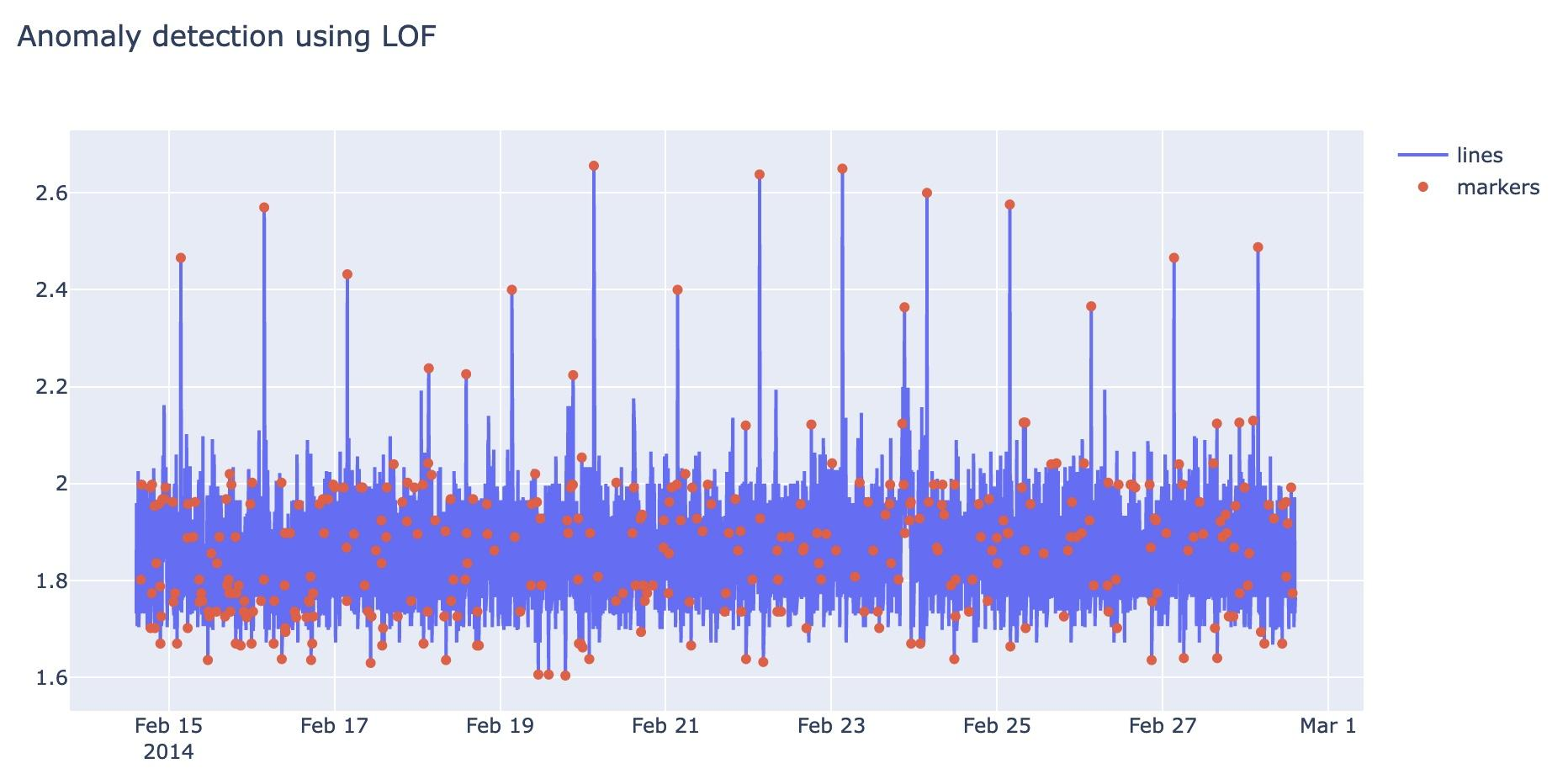
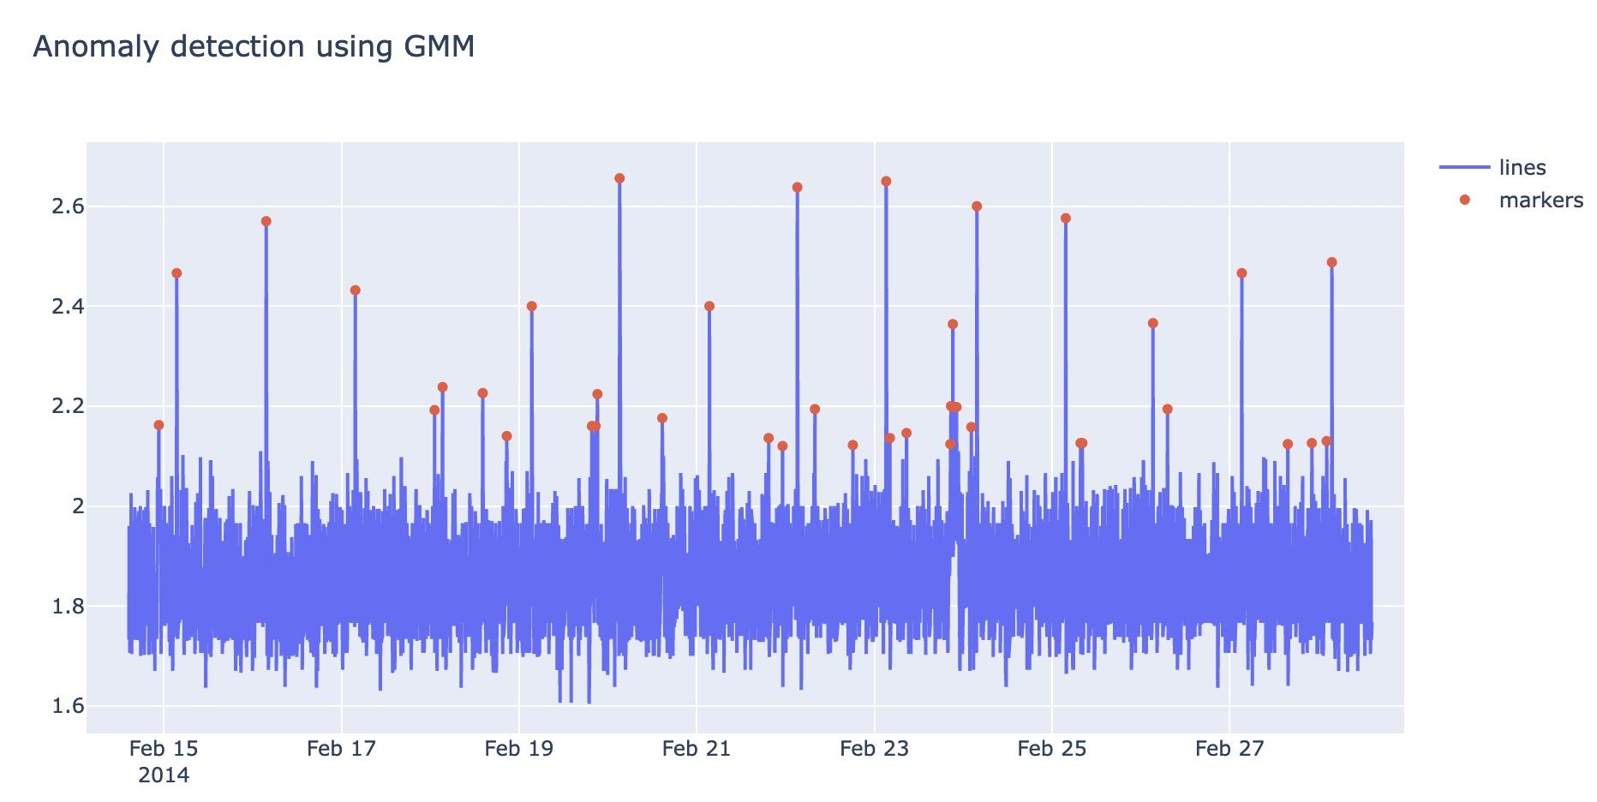
Local Outlier Factor
The Local Outlier Factor computes the local density deviation of a given data point with respect to its neighbors. It considers as outliers the samples that have a substantially lower density than their neighbors
GMM
The algorithm finds its distance from every distribution & hence the probability of that point belonging to each cluster. Therefore if for a particular cluster, if the probability is very low that’s an indication of the data point being an anomaly.

Slide 8
Result
Future Work
Algorithm | EM - Value
One Class SVM | 0.011641
Isolation Forest | 0.101893
Local Outlier Factor(LOF) | 0.072206
Gaussian Mixture Model(GMM) | 0.020273
In future we can automate this whole process as we now know the best algorithm that works best on this type of data.
The data would be live streaming data that we can directly access through the database.
This model won’t just be used for CPU utilization but for all kinds of AWS metrics.
In our case Isolation forest works best followed by LOF. One Class SVM is the worst performing algorithm.

Slide 9
Thank you

